Slide 1
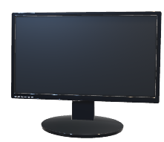



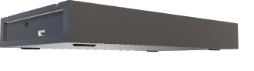
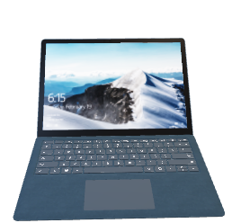


Azure Resource Group
Azure Virtual Network: 10.0.0-16
Subnet Range: 10.0.0/24
Internet
SSH
Security Group:Red_sg
HTTP
SSH
Load Balancer
52.137.112.232
Jump Box
Ansible
20.94.192.227
10.0.0.4
Workstation
Web-1
10.0.0.5
Web-2
10.0.0.5
Backend Pool

